Slide 2
understand what is data stream.
learn Use Cases for Real-Time and Streaming Data
understand Data Lake
differentiate between data lake vs data warehouse

Slide 3
What Does Big Data Streaming Mean
Big data streaming is a process in which big data is quickly processed in order to extract real-time insights from it.
The data on which processing is done is the data in motion.
Big data streaming is ideally a speed-focused approach wherein a continuous stream of data is processed.

Slide 4

What Does Big Data Streaming Mean

Slide 5
Data Streaming
Big data streaming is a process in which large streams of real-time data are processed with the sole aim of extracting insights and useful trends out of it.

Slide 6
Data Streaming
Stream1
Stream1
.
.
.
Stream1

Slide 7

Data Streaming
Stream1
Stream1
.
.
.
Stream1
Unstructured Data

Slide 8

Data Streaming
Stream1
Stream1
.
.
.
Memory
Stream1
Unstructured Data

Slide 9
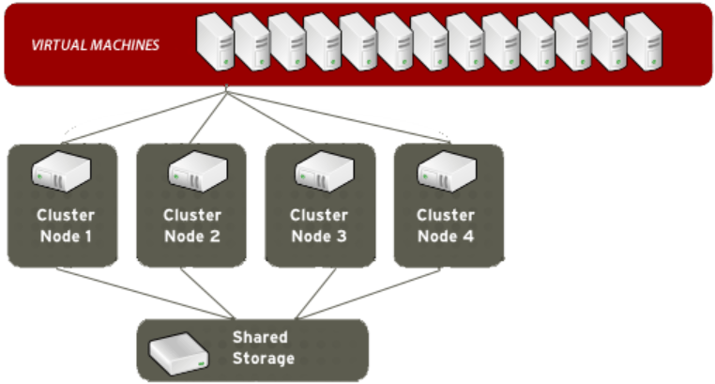
Data Streaming
Cluster of servers

Slide 10
Data Streaming
Speed matters the most in big data streaming.
The value of data, if not processed quickly, decreases with time.
Real-time streaming data analysis is a single-pass analysis.
Analysts cannot choose to reanalyze the data once it is streamed.

Slide 11

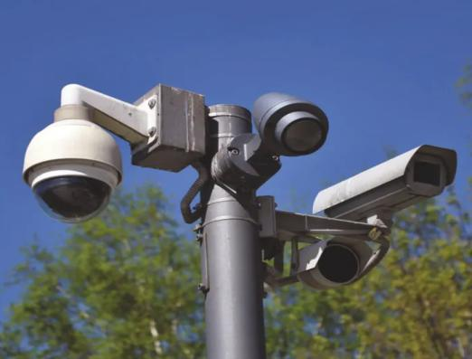
Data Streaming
Social Media
Camera or Sensors

Slide 12
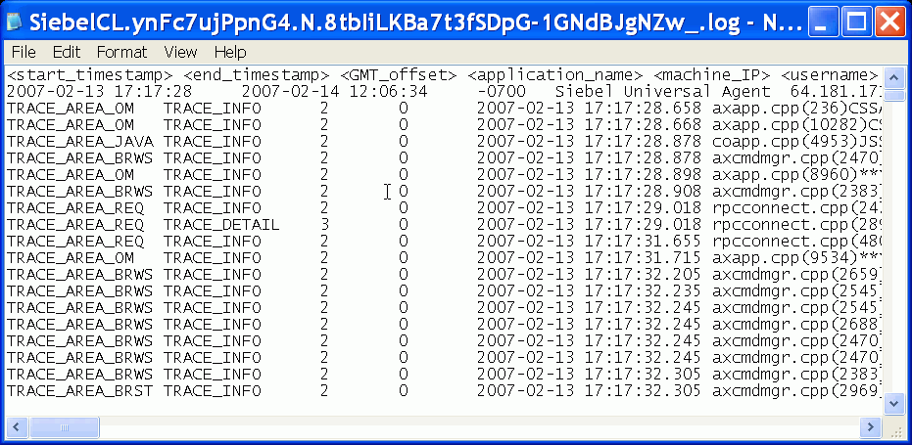
Example Where Real Time Streaming Data Is Created (Log Files)

Slide 13
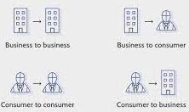
Example Where Real Time Streaming Data is Created
E-commerce Purchases

Slide 14

Example Where Real Time Streaming Data is Created
Weather Events

Slide 15
Example Where Real Time Streaming Data is Created
Weather Events
Utility Service Usage

Slide 16

Example Where Real Time Streaming Data is Created
Geo-Location

Slide 17
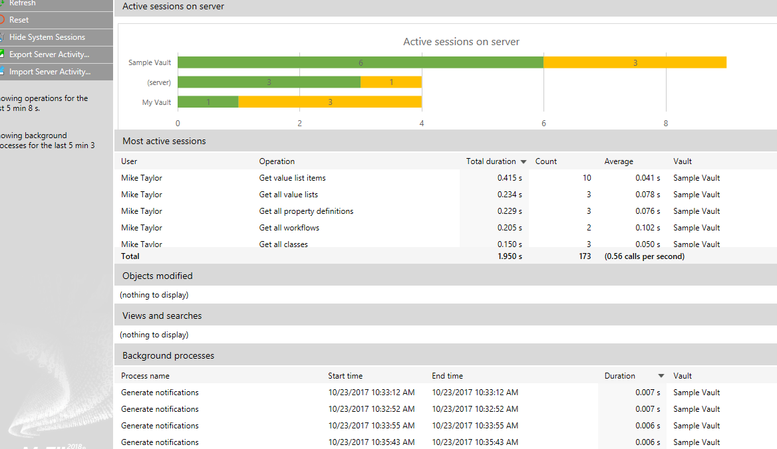
Example Where Real Time Streaming Data is Created (Service Activity)

Slide 18
Data Streaming
When companies are able to analyze streaming data they receive, they can get real-time insights to understand exactly what is happening at any given point in time.
This enables better decision-making as well as provide customers with better and more personalized services.
Nearly every company is or can use streaming data.

Slide 19
Use Cases for Real-Time & Streaming Data

Slide 20
Use Cases for Real-Time and Streaming Data
Predictive maintenance:
Healthcare
Retail
Social media
Finance:
Energy and power
Personalization of products and services:
Transportation and supply-chain
KPIs

Slide 21
Predictive Maintenance

Slide 22

Predictive maintenance
Maintenance Issues

Slide 23
Predictive maintenance
Maintenance Issues
Camera or Sensors

Slide 24

Predictive Maintenance (Monitoring Performance)

Slide 25
Healthcare

Slide 26

HealthCare
Wearable Technology in healthcare

Slide 27
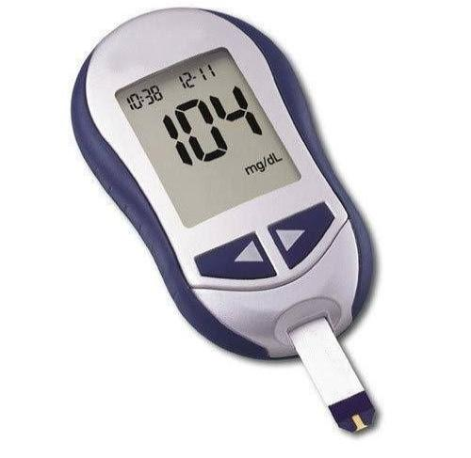
HealthCare
Glucometer

Slide 28

HealthCare
Smart Scales

Slide 29
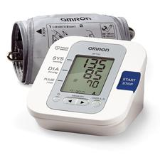
HealthCare
Heart Rate and Blood Pressure Monitor

Slide 30
Retail

Slide 31
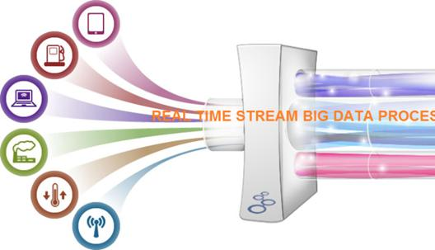
Retail

Slide 32
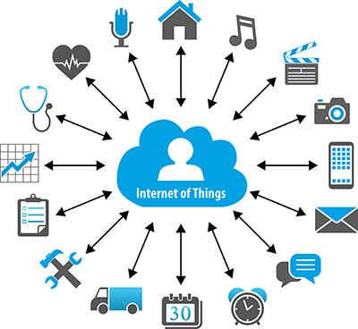
Retail
IOT Sensors

Slide 33
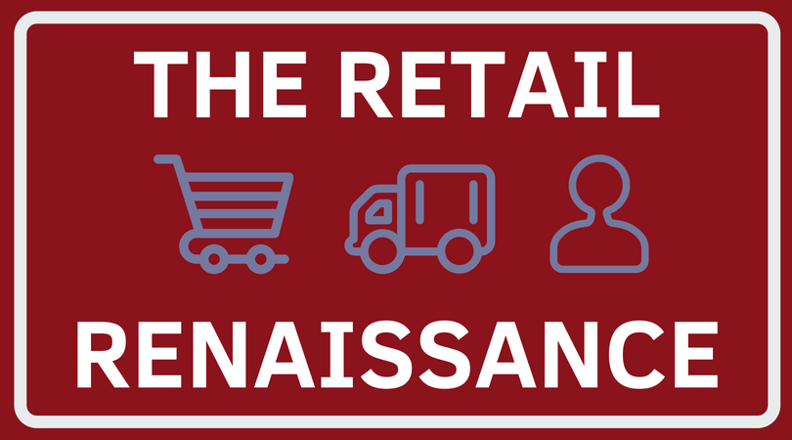
Retail

Slide 34
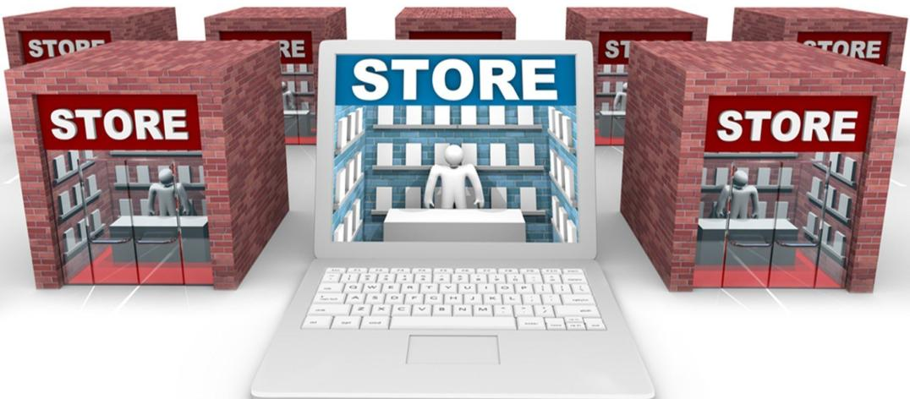
Retail
Brick and Mortal Stores

Slide 35


Retail
What are possible with real time data?
Location Based Marketing

Slide 36
Retail
What are possible with real time data?
Location Based Marketing
Trend Insight

Slide 37
Retail
What are possible with real time data?
Location Based Marketing
Trend Insight
Improvement to Operational efficiency
Product Movement
Product Freshness

Slide 38
Social media

Slide 39

Social media

Slide 40

Social media
Social media bullying

Slide 41
Finance

Slide 42

Finance
Trading floors

Slide 43

Finance

Slide 44
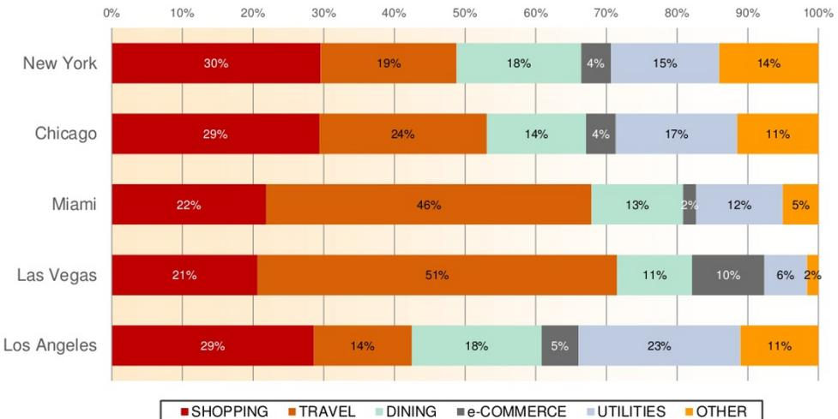
Finance (Identify Fraudulent Merchants)

Slide 45

Finance

Slide 46
Energy and Power

Slide 47
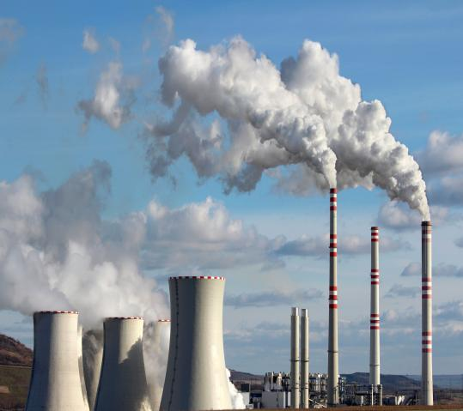

Energy and Power
Fossil Fuels

Slide 48
Personalization of Products and Services

Slide 49

Personalization of Products and Services
Streaming Data

Slide 50

Personalization of Products and Services
Online News Publication

Slide 51
Transportation and Supply-chain:

Slide 52
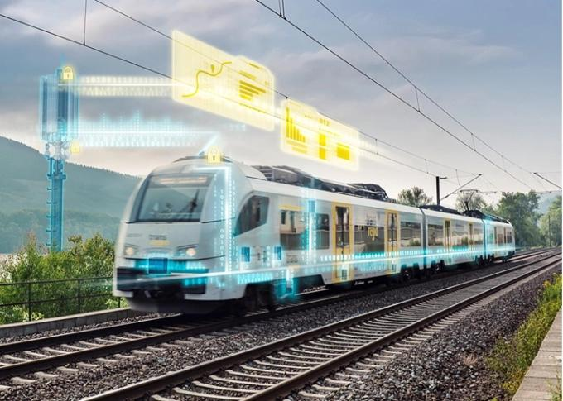
Transportation and Supply-chain:
Internet of Trains

Slide 53
KPIs

Slide 54
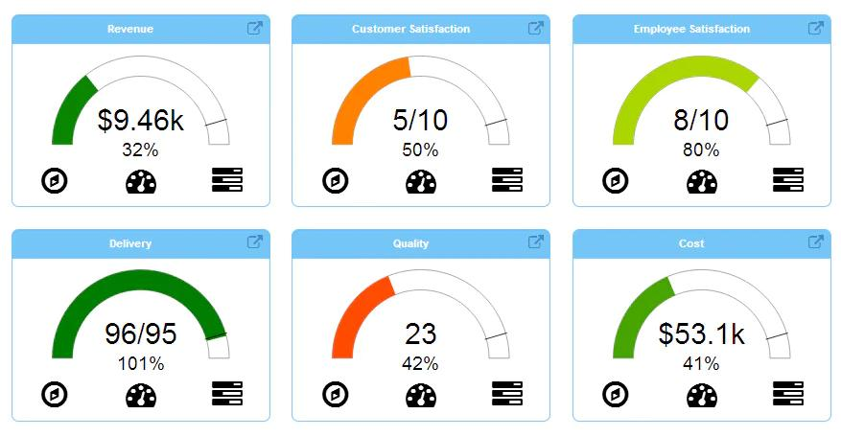
KPIs
Real Time KPIs

Slide 55
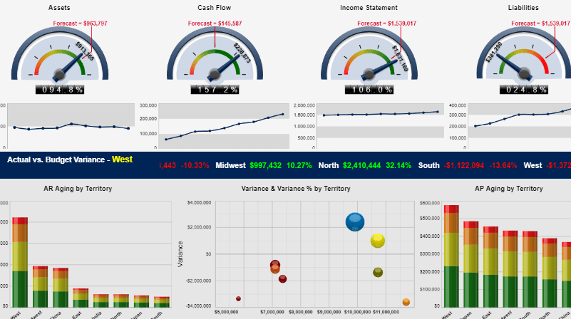
KPIs
Financial

Slide 56
KPIs
Financial

Slide 57
Data Lake

Slide 58
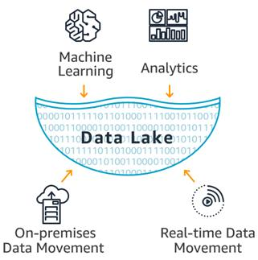
What is a Data Lake?

Slide 59
Why do You Need a Data Lake?
Organizations that successfully generate business value from their data, will outperform their peers.

Slide 60
Why do You Need a Data Lake?
This helped them to identify, and act upon opportunities for business growth faster by attracting and retaining customers, boosting productivity, proactively maintaining devices, and making informed decisions.

Slide 61
Why do You Need a Data Lake?
This helped them to identify, and act upon opportunities for business growth faster by attracting and retaining customers, boosting productivity, proactively maintaining devices, and making informed decisions.

Slide 62
Data Lakes compared to Data Warehouses
Characteristics | Data Lakes | Datawarehouse
Data | Relational from transactional systems, operational databases, and line of business applications | Non-relational and relational from IoT devices, web sites, mobile apps, social media, and corporate applications
Schema | Designed prior to the DW implementation (schema-on-write) | Written at the time of analysis (schema-on-read)
Price/Performance | Fastest query results using higher cost storage | Query results getting faster using low-cost storage

Slide 63
Data Lakes compared to Data Warehouses
Characteristics | Data Lakes | Datawarehouse
Data Quality | Highly curated data that serves as the central version of the truth | Any data that may or may not be curated (ie. raw data)
Users | Business analysts | Data scientists, Data developers, and Business analysts (using curated data)
Analytics | Batch reporting, BI and visualizations | Machine Learning, Predictive analytics, data discovery and profiling

Slide 64
The Essential Elements of a Data Lake and Analytics Solution
Data movement
Securely store, and catalog data
Analytics
Machine Learning

Slide 65
The Value of a Data Lake
Improved customer interactions
Improve R&D innovation choices
Increase operational efficiencies

Slide 66
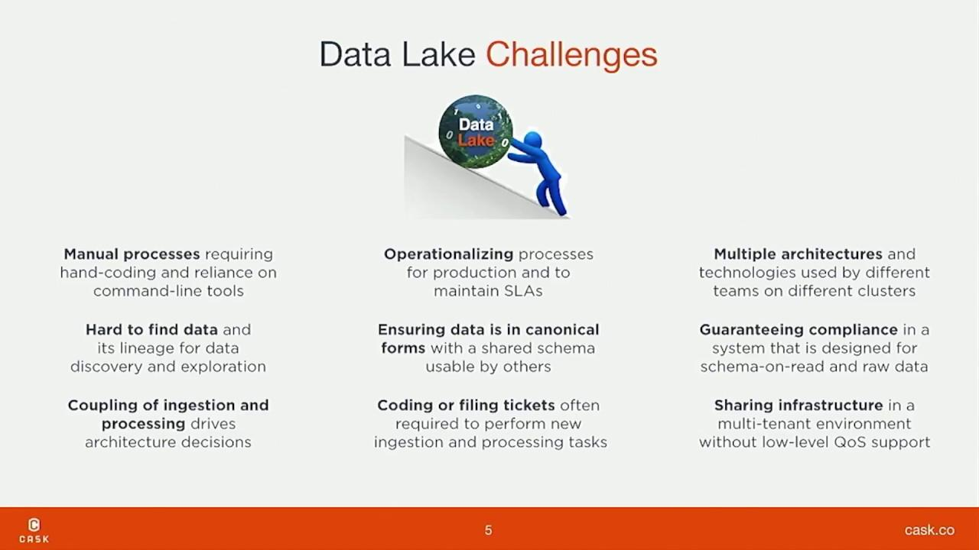
The Challenges of Data Lake

